Slide 1

Introduction to Single-cell RNA-Seq
Wally the Welsh Corgi

Slide 2
Connecting & Computer Preliminaries
Make sure your workshop provided computer is connected to the “Broad” or “Broad Internal” wireless network.
Please do not connect your personal items
(laptop, phone, etc.) to these wireless networks; it will tax the wireless system and make the workshop less effective.
The password for computers is “password”.

Slide 3
Introduction to single-cell RNA-Seq
Center for Cell Circuits Computational Genomics Workshop 2017
Timothy Tickle
Brian Haas
Asma Bankapur

Slide 4
We Know Tissues are Heterogeneous
Notes:
Lamina Propria- loose connective tissue
Peristalsis
Eosinophil-white blood cell that stains well with Eosin.
Band neutrophil/Segmented neutrophil-Neutrophils, are also known as "segs", "PMNs" or "polys" (polymorphonuclears). They are the body's primary defense against bacterial infection and physiologic stress.
Basophil-white blood cell
Platelet-blood coting
lymphocyte-immune system
Monocyte-a large phagocytic white blood cell with a simple oval nucleus and clear, grayish cytoplasm.

Slide 5

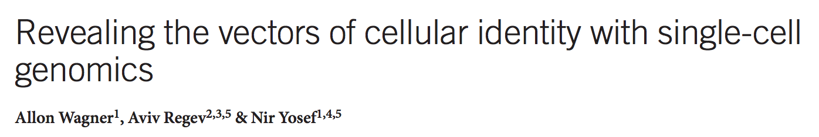
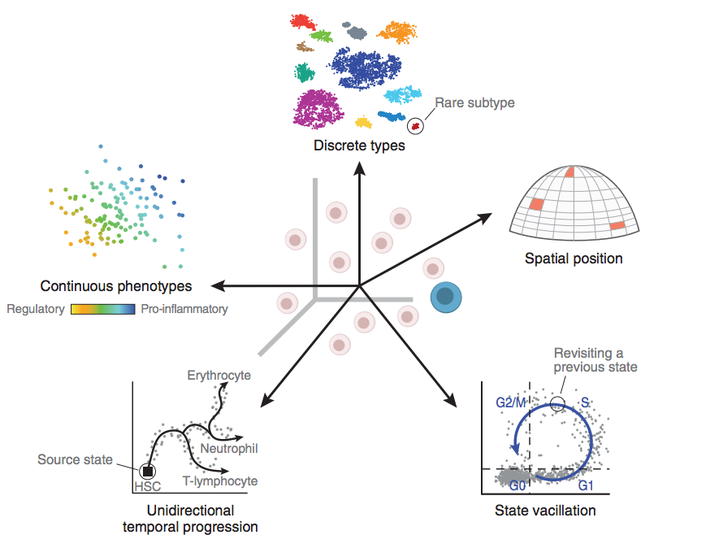
Cell Identity is More Than Histopathology
A cell participates in
multiple cell contexts.
Multiple factors shape a cell’s identity
Membership in a taxonomy
of cell types
Simultaneous time-
dependent processes
Response to the
environment
Spatial positioning

Slide 6
Before We Get Started
Single-cell RNA-Seq (scRNA-Seq) analysis methodology is developing.
Give you a feel for the data.
Perform some analysis together.
There is a vivid diversity of methodology.
These technique will grow as the field does.
Why were these specific tools chosen?
This is a guided conversation through scRNA-Seq analysis.
Breadth and targeted depth.
There may be other opinions, if you have one, please speak up so we can all learn from it.

Slide 7
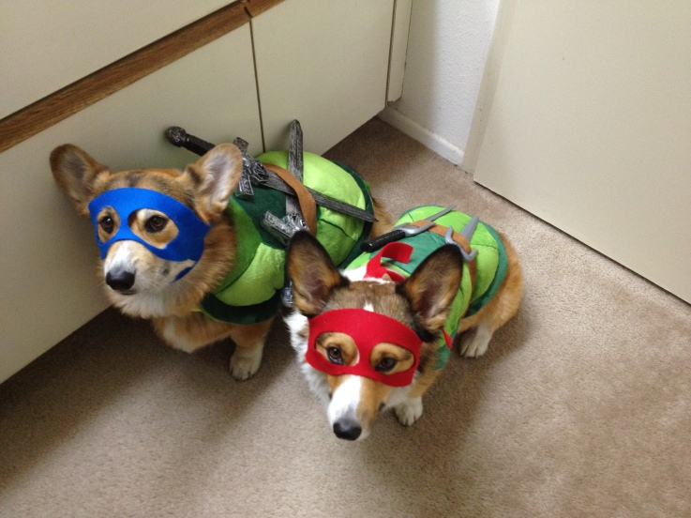
Before We Get Started
Sections will be hands-on.
Much can be applied to other analysis.
Strengthen those R ninja skills!
If you need, cut and pasting is available.
cut_and_paste.txt
There will be many cute corgi pictures.

Slide 8
We Will Attempt to Cover
Describe scRNA-Seq assays.
Comparing assays.
Sequence pipelines.
How do measured counts behave?
Concerns over study design.
Initial data exploration.
Gene and cell filtering.
Plotting genes.
Dimensional Reduction and plotting cells.
Differential expression.
Communicating your study.

Slide 9
Section: scRNA-Seq Assays
There are many scRNA-Seq Assays, each differs:
Some commercialized
Full transcriptome vs 3’
Less or more automated
Different levels of throughput
Differences in cost

Slide 10
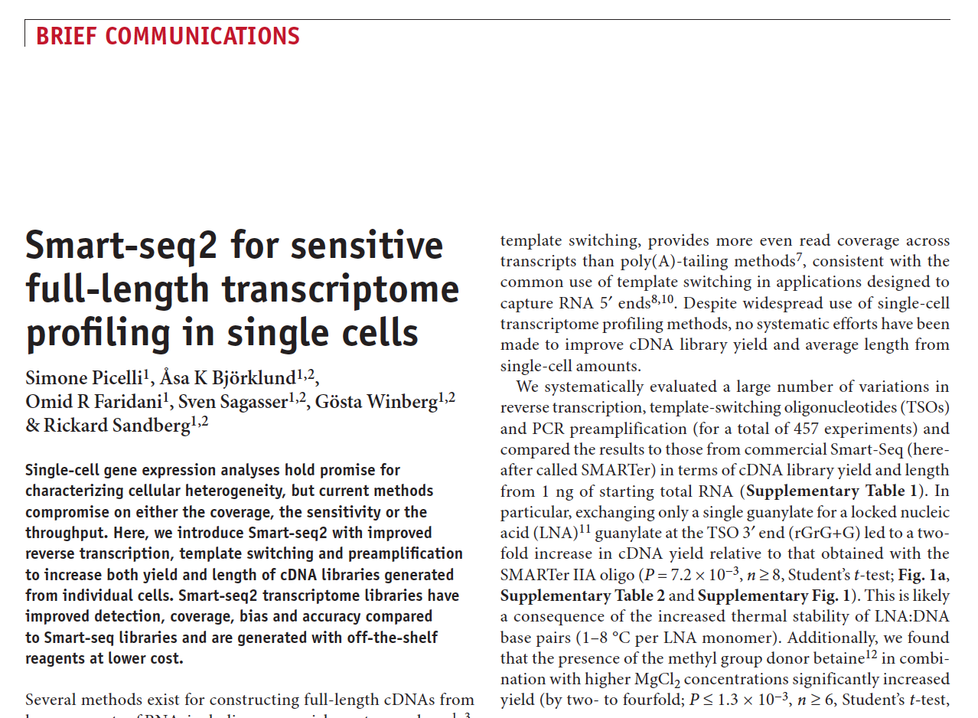
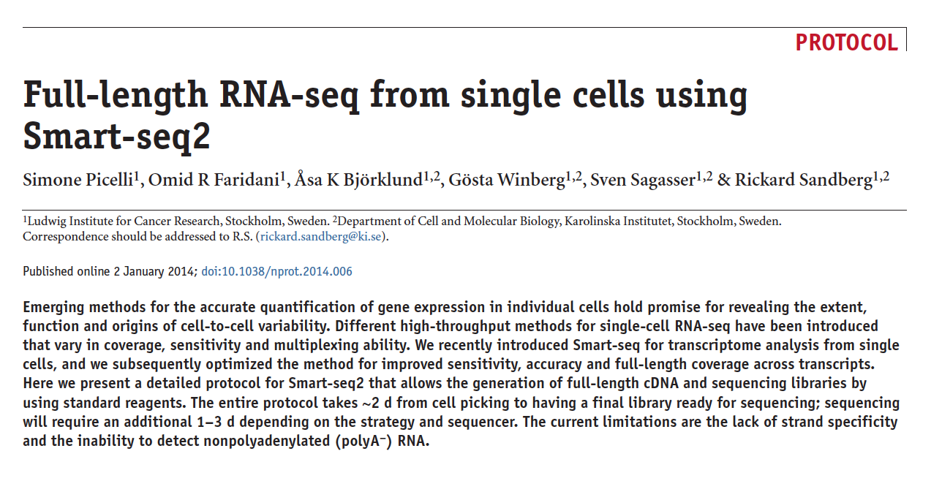
Smart-Seq2

Slide 11
Smart-Seq2: Description
Full transcript scRNA-Seq
Developed for single cell but can performed using total RNA.
Selects for poly-A tail.
Full transcript assay.
Uses template switching for 5' end capture.
Standard illumina sequencing.
Off-the-shelf products.
Hundreds of samples.
Often do not see UMI used.

Slide 12
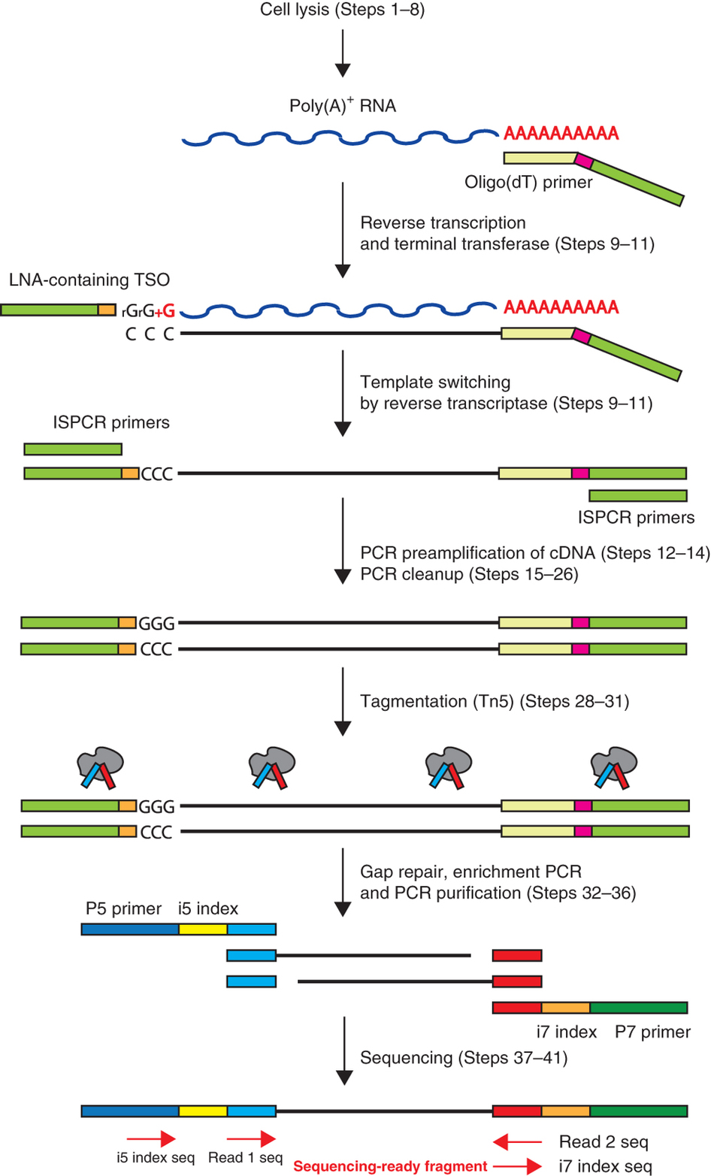
Smart-Seq2: Assay Overview
Poly-A capture with 30nt polyT and 25nt 5' anchor sequence.
RT adding untemplated C
Template switching
Locked Nucleic Acid binds to untemplated C
RT switches template
Preamplification / cleanup
DNA fragmentation and adapter ligation together.
Gap Repair, enrich, purify.

Slide 13
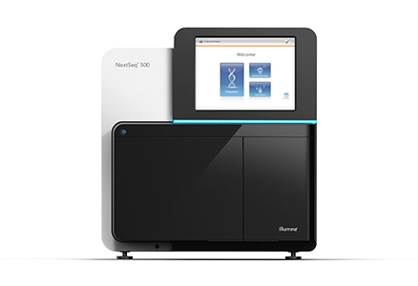
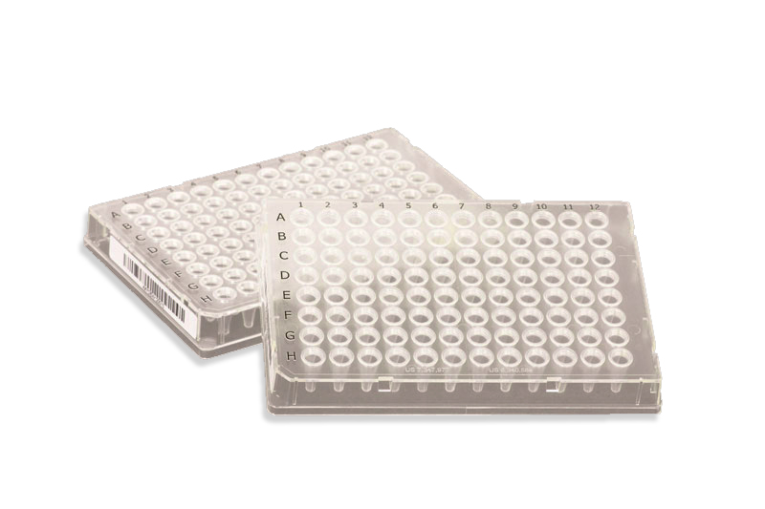
Smart-Seq2: Equipment

Slide 14
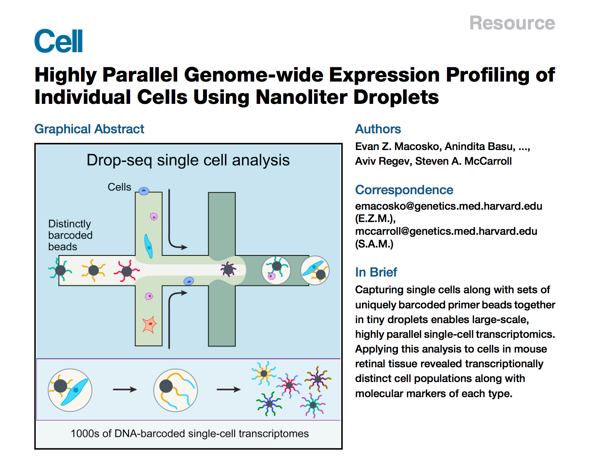
Drop-seq

Slide 15
Drop-seq: Description
Moved throughput from hundreds to thousands.
Droplet-based processing using microfluidics
Nanoliter scale aqueous drops in oil.
3' End
Bead based (STAMPs).
Single-cell transcriptomes attached to microparticles.
Cell barcodes use split-pool synthesis.
Uses UMI (Unique Molecular Identifier).
RMT (Random Molecular Tag).
Degenerate synthesis.

Slide 16
Drop-seq: Overview
Click Here for Drop-seq Video Abstract

Slide 17
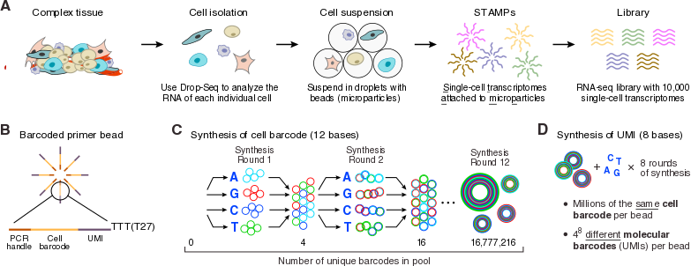
Drop-seq: Assay Overview

Slide 18
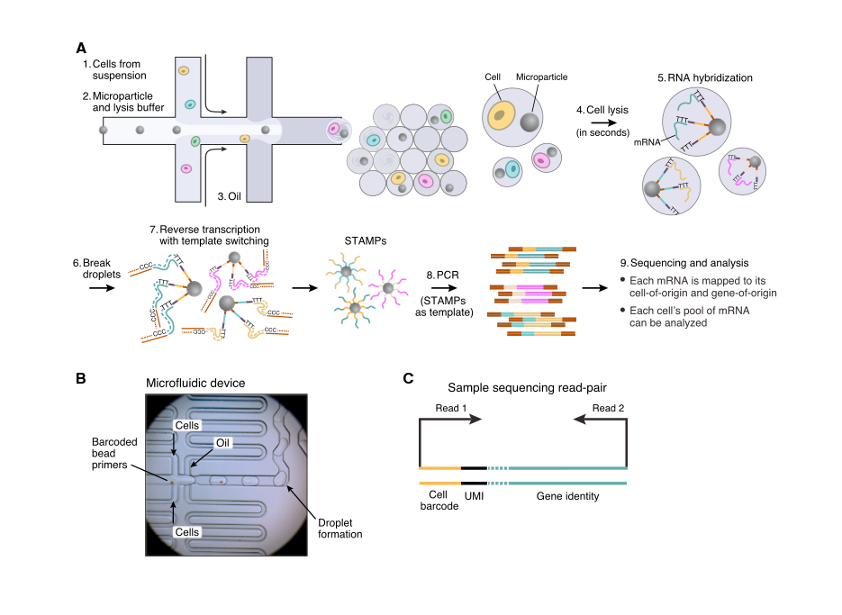
Drop-seq: Assay Overview

Slide 19
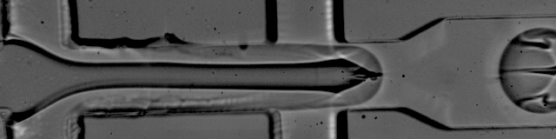
Drop-seq: Assay Overview

Slide 20
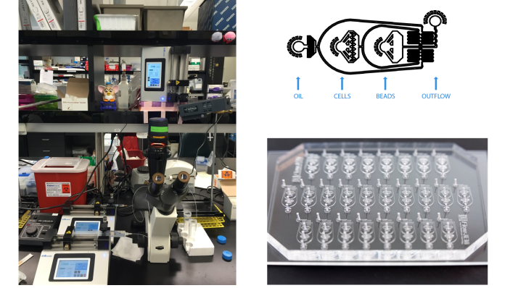
Drop-seq: Equipment

Slide 21
Drop-seq: Pointers
Droplet-based assays can have leaky RNA.
Before library generation wash off any medium (inhibits library generation).
Adding PBS and BSA (0.05-0.01%) can protect the cell.
Too much produces a residue making harvesting the beads difficult.
Filter all reagent with a 80 micron strainer before microfluidics.
Some purchased devices add a hydrophobic coating.
Can deteriorate (2 months at best).
Recoating does work (in-house).

Slide 22
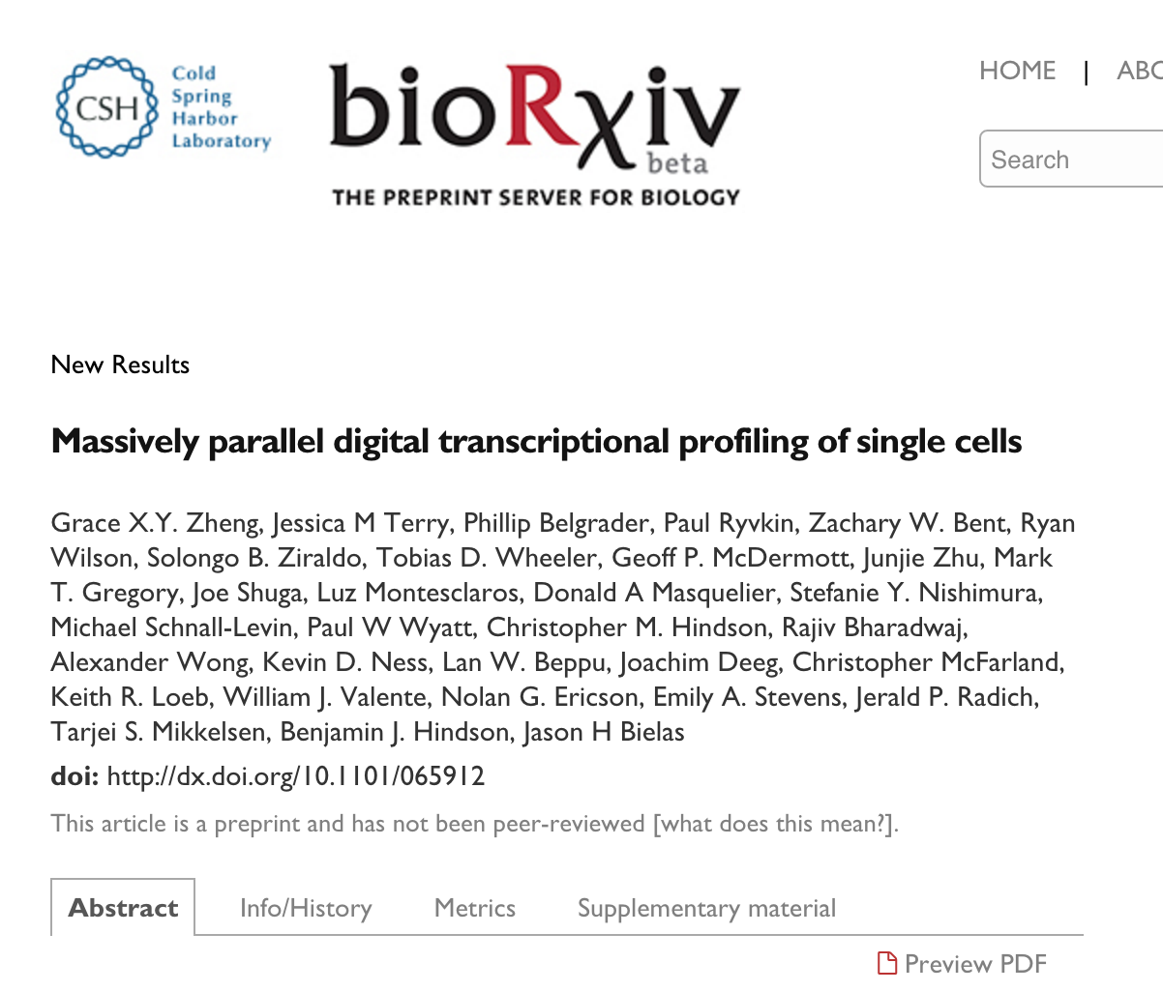
10X: Massively Parallel Sequencing

Slide 23
10X: Description
Droplet-based, 3' mRNA.
GEM (Gel Bead in Emulsion)
Standardized instrumentation and reagents.
More high-throughput scaling to tens of thousands.
Less processing time.
Cell Ranger software is available for install.

Slide 24
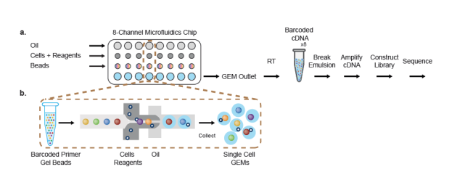
10X: Assay Overview

Slide 25
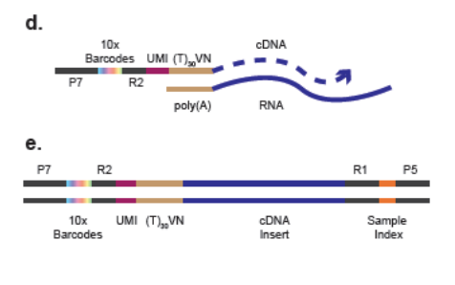
10X: Assay Overview

Slide 26
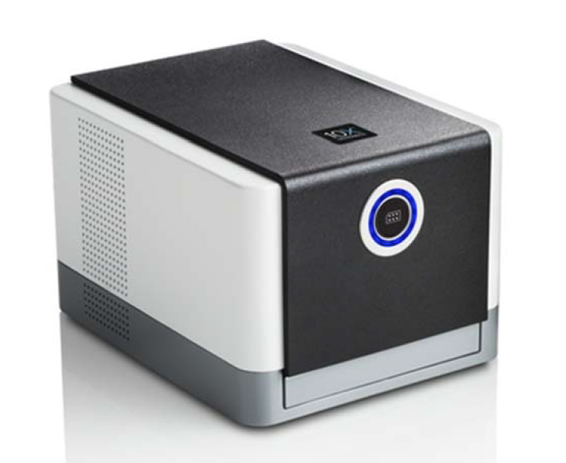
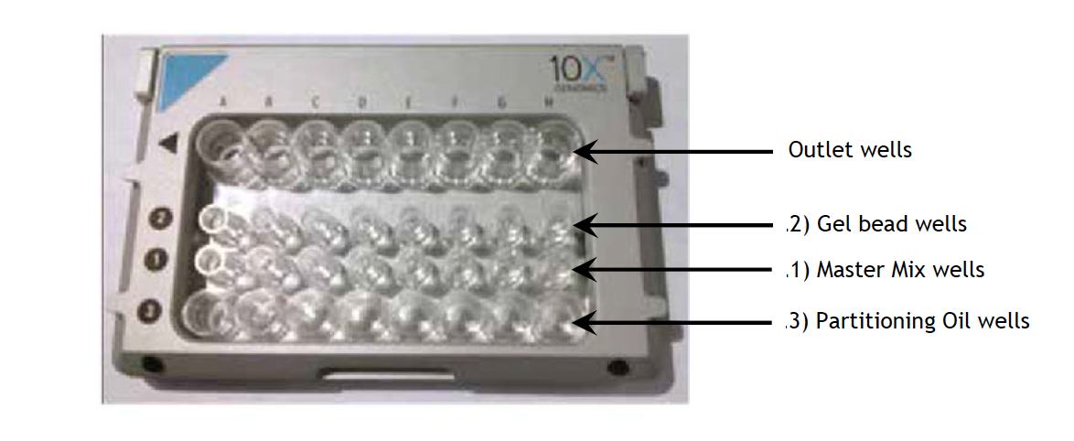
10X: Equipment

Slide 27
A Word on Sorting
After disassociating cells cells can be performed.
Know your cells, are they sticky, are they big?
Select an appropriate sized nozzle.
Don't sort too quickly (1-2k cells per second or lower)
The slower the more time cells sit in lysis after sorting
10 minutes max in lysis (some say 30 minutes)
Calibrate speed of instrument with beads
Check alignment every 5-6 plates
Afterwards spin down to make sure cells are in lysis buffer
Flash freeze
Chloe Villani on sorting [click here]

Slide 28

Section: Comparing scRNA-Seq Assays

Slide 29
Sequences from Assays are Different

Slide 30
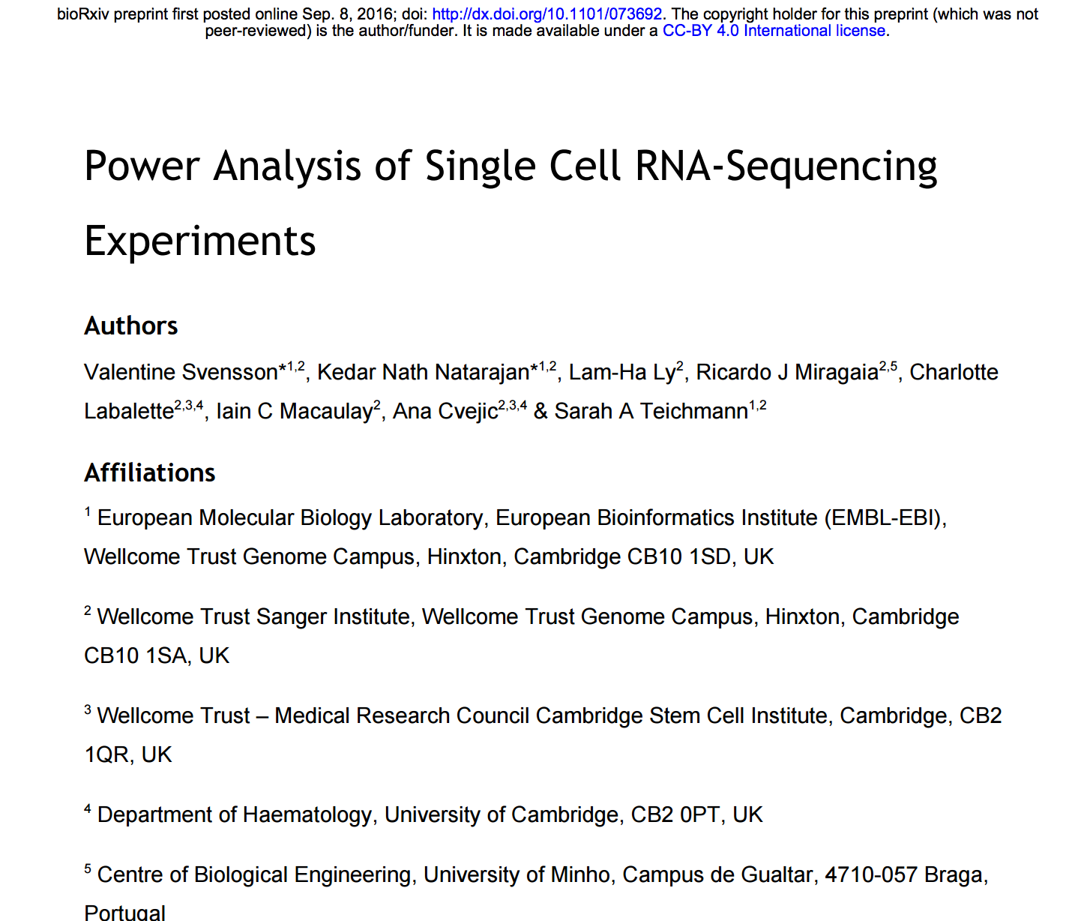
scRNA-Seq Assay Performance

Slide 31
ERCC-based Benchmarking
Based on ERCC spike-ins.
Exogenous RNA-Spikins
No secondary structure
25b polyA Tail
May be a conservative measurement given endogenous mRNA will have ~250b polyA.
Accuracy
How well the abundance levels correlated with known spiked-in amounts.
Sensitivity
Minimum number of input RNA molecules required to detect a spike-in.

Slide 32
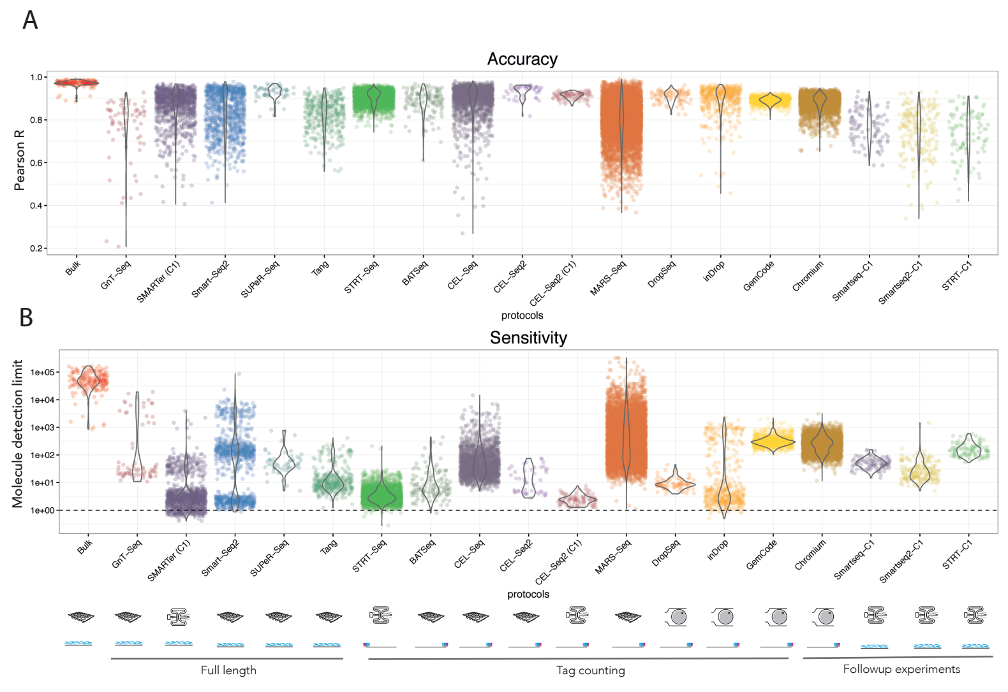
Sensitivity and Specificity
Drop-Seq
Bulk
Smart-Seq2
CEL-Seq2
10X
Great!
Accuracy
Poor
Bulk
Sensitivity
10 molecules
1 molecule
Great!
Notes:
All have great accuracy.
Some have better sensitivity than others:
All better than bulk
Many between 10 and 1 molecule detection
Sensitivity is dependent on depth, you could sequence more deeply if needed.
Sensitivity is critical when you are studying lowly expressed genes.

Slide 33
Final Thoughts
Different assays have different throughput.
SmartSeq2 < Drop-seq < 10X
SmartSeq2 is full transcript.
Plate-based methods get lysed in wells and so do not leak.
Droplet-based can have leaky RNA.
In Drop-seq assays RT happens outside the droplets
Can use harsher lysis buffers.
10X needs lysis buffers compatible with the RT enzyme.
10X is more standardized and comes with a pipeline.
Drop-seq is more customizable but more hands-on.
Cost per library varies greatly.

Slide 34

Section: scRNA-Seq Pipelines

Slide 35
Sequences Differ So Pipelines Differ
scRNA-Seq assays are different and produce different sequences
The sequence pipelines must be tailored to the sequence of interest.
Many pipelines are NOT compatible but many show similarities.

Slide 36
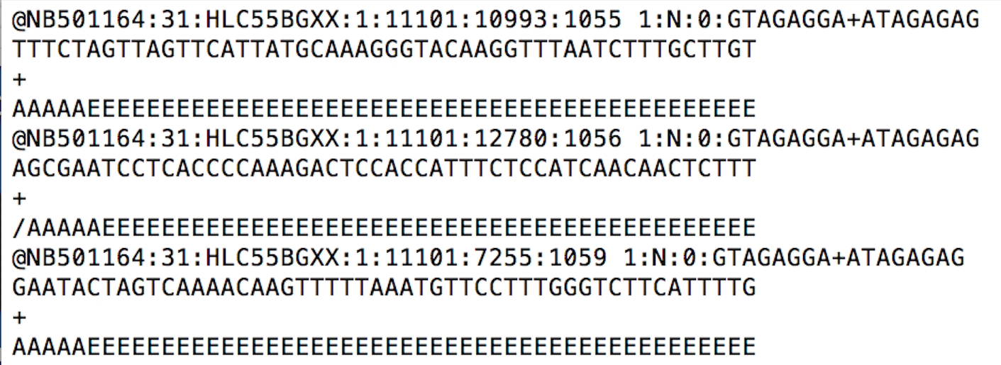
Start with FASTQ Sequences
FASTQ File Format
Sequence Header
cDNA Sequence
Base Quality
4 Lines are 1
sequence

Slide 37
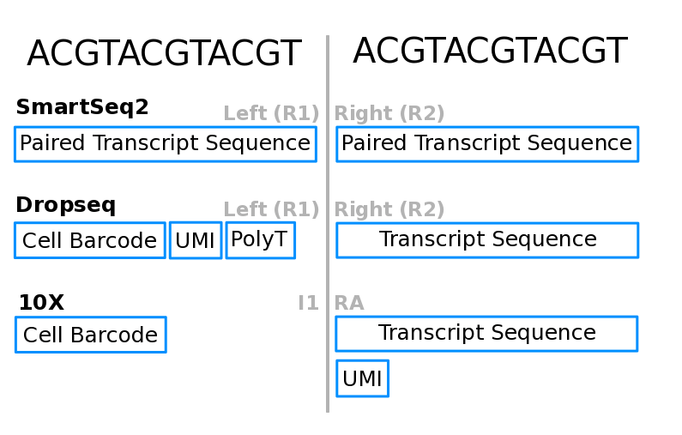
Assays Differ in FASTQ Contents

Slide 38
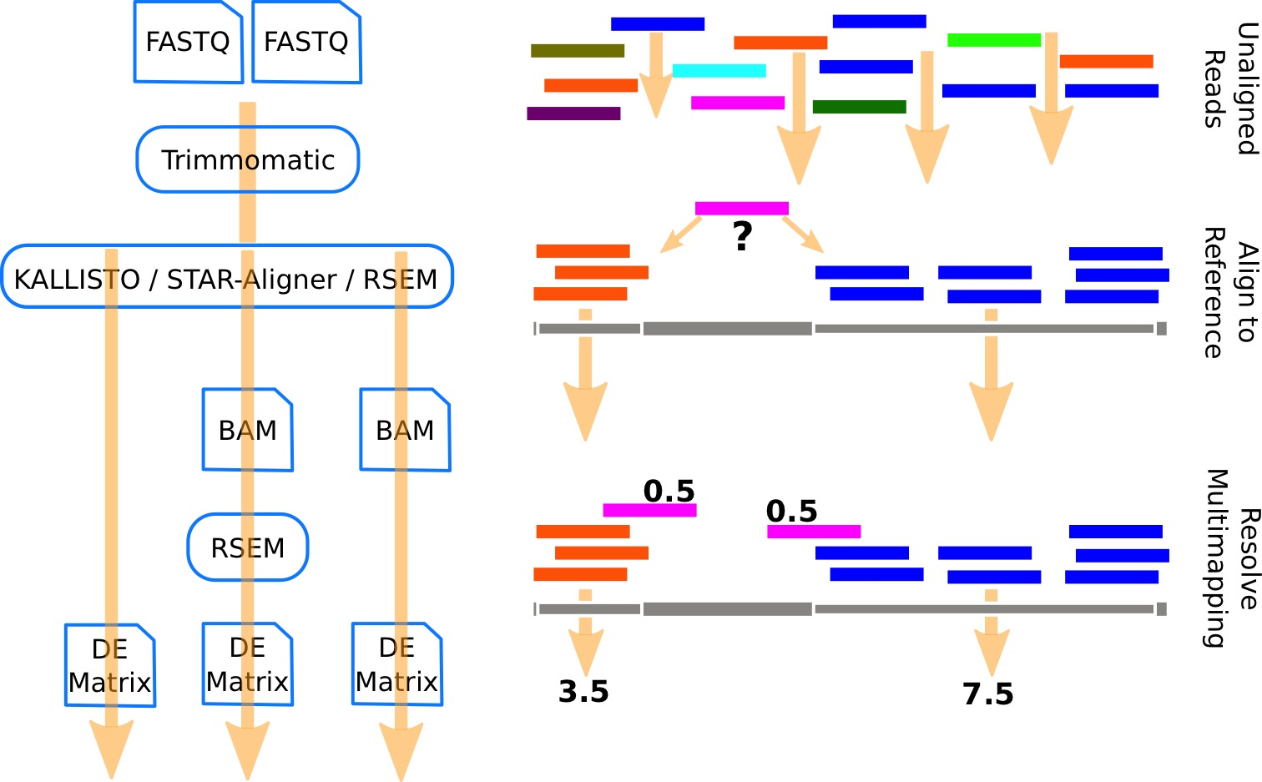
SmartSeq2: Pipeline Overview

Slide 39
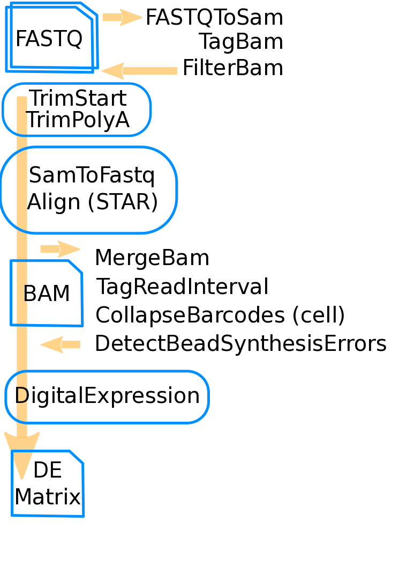
Drop-seq: Pipeline Overview
Common functionality: trimming, alignment, generating count matrix.
Adds book keeping for cell barcodes and UMIs, bead error detection, cell barcode collapsing, UMI collapsing.

Slide 40
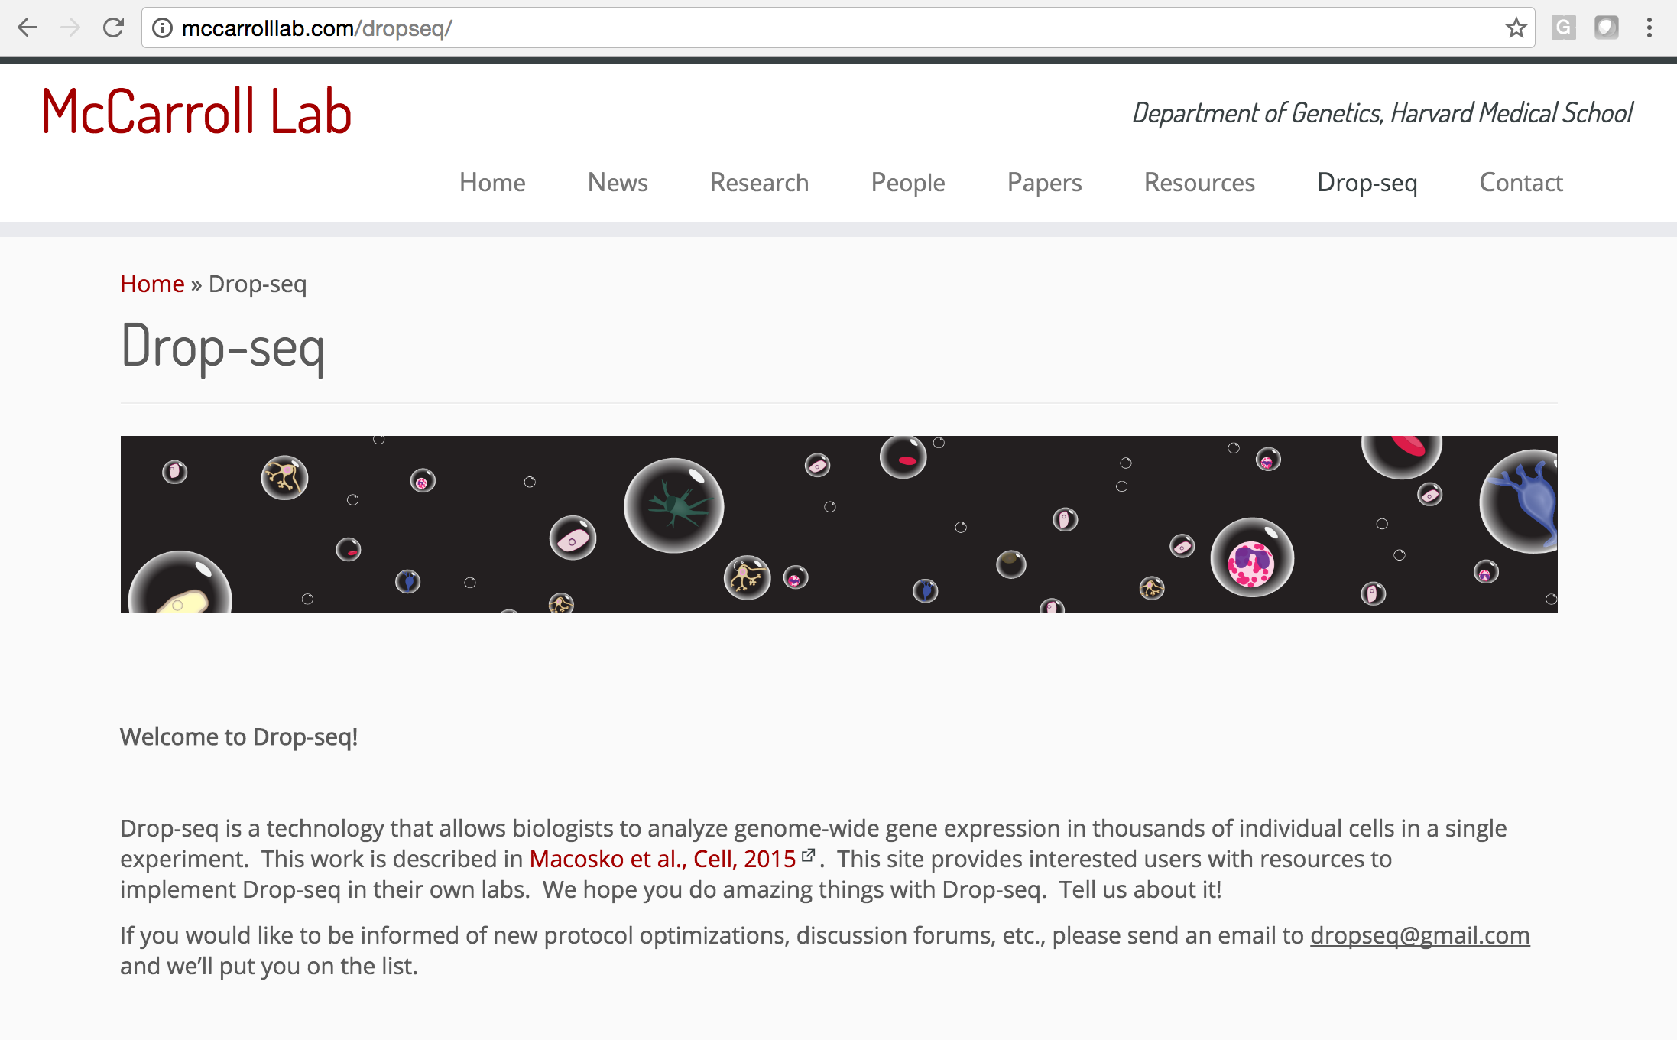
Drop-seq: Further Help

Slide 41
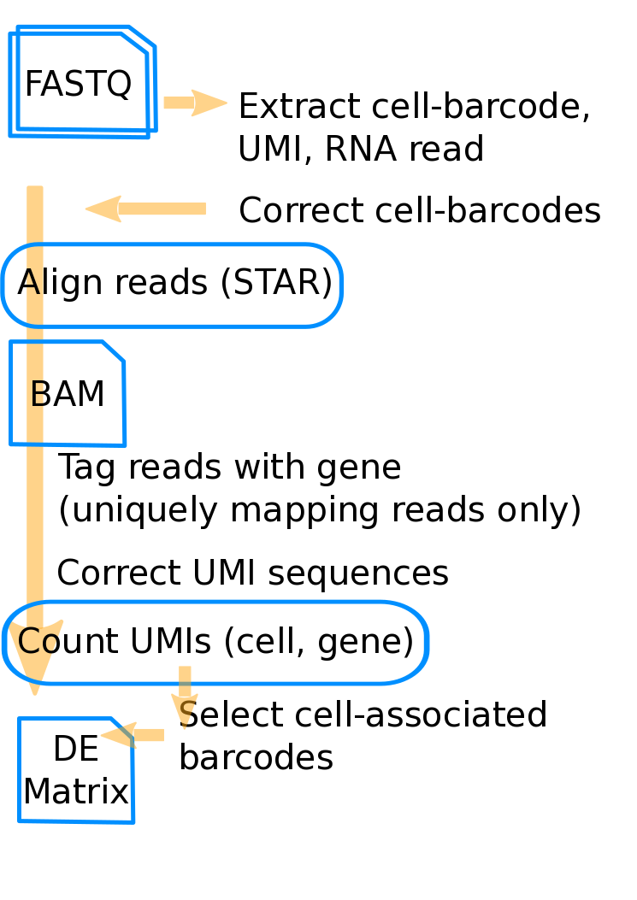
10X: Pipeline Overview
Steps conceptually similar to the Drop-seq pipeline.

Slide 42
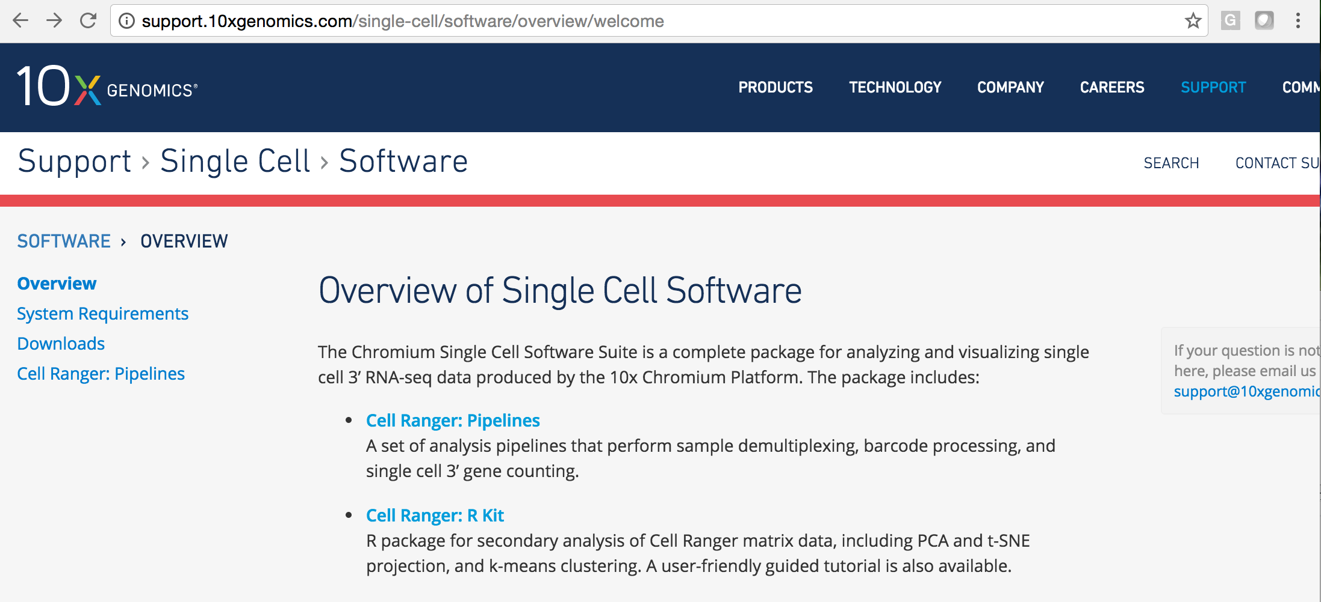
10X: Further Help

Slide 43
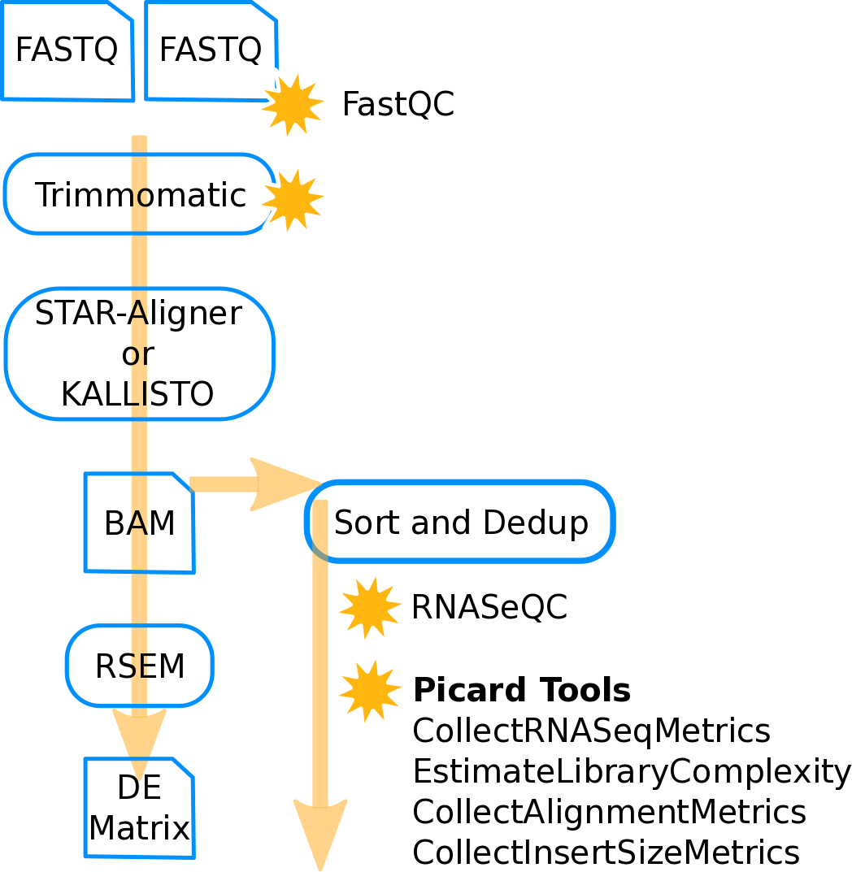
Sequence Level Quality Control
Much of the QC that is performed is using traditional tools.

Slide 44
Pipeline Section Summary
Single-cell RNA-Seq is a diverse ecosystem of assays.
Each assay has pros and cons.
Sequences derived from these assays are complex and vary.
Different pipelines are needed to address different sequence formats.
Common steps include:
Aligning
QC
Read counting.

Slide 45

Section: scRNA-Seq Count Data

Slide 46
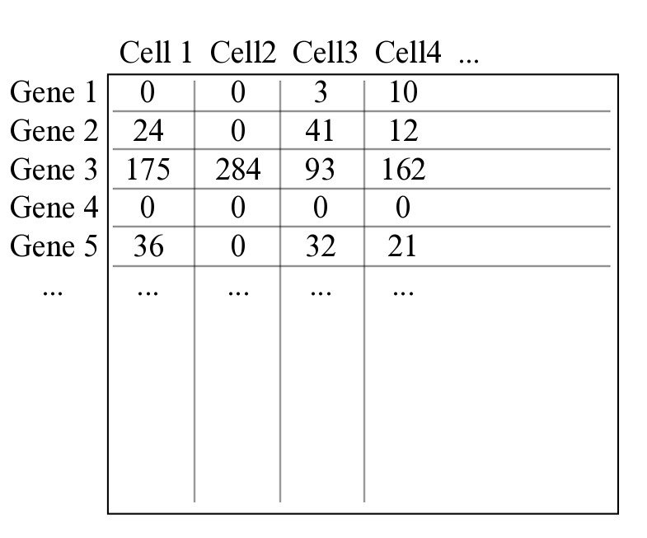
This is an Expression Matrix

Slide 47
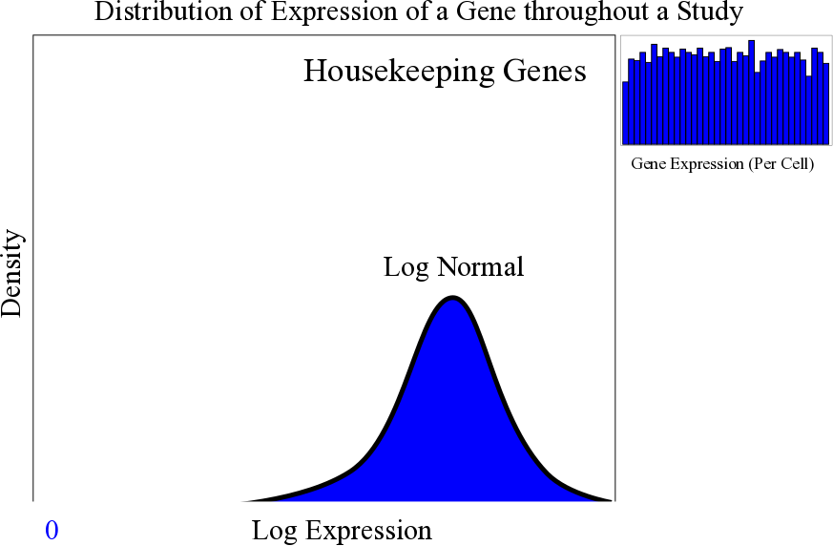
Genes Have Different Distributions

Slide 48
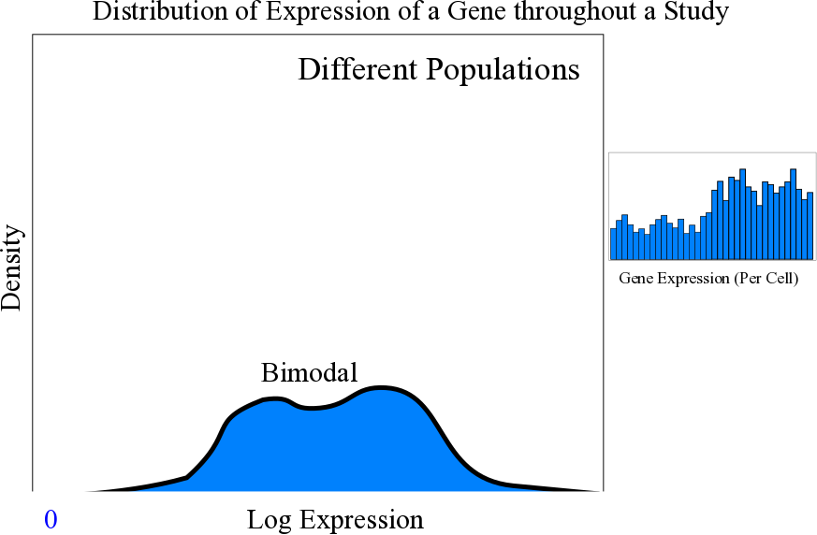
Genes Have Different Distributions

Slide 49
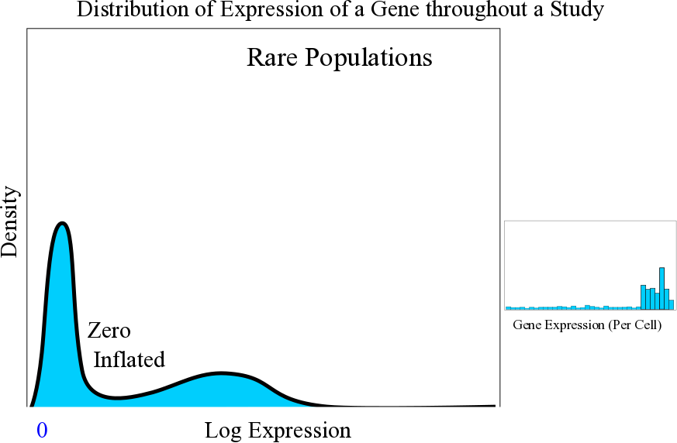
Genes Have Different Distributions

Slide 50
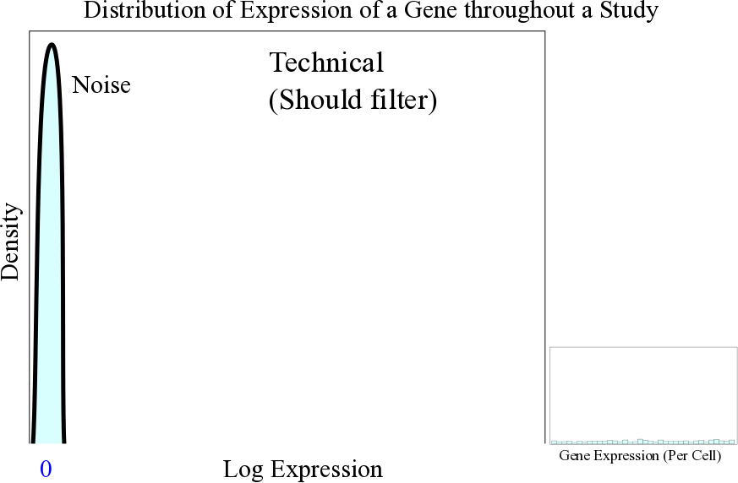
Genes Have Different Distributions

Slide 51
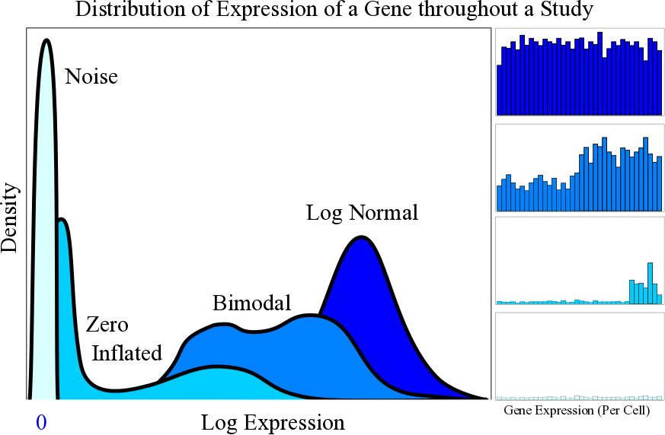
Genes Have Different Distributions

Slide 52
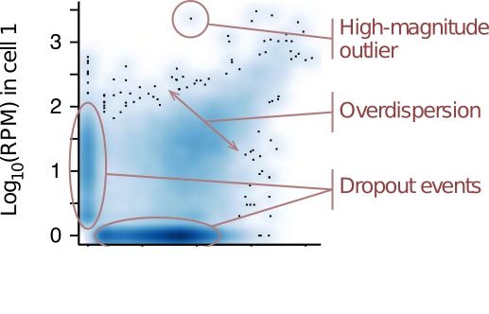
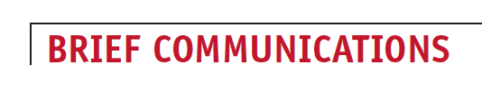
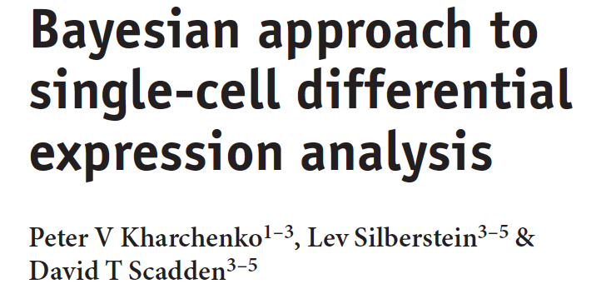
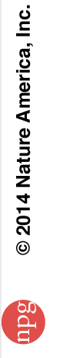
Underlying Biology
Zero inflation.
Drop-out event during reverse-transcription.
Genes with more expression have less zeros.
Complexity varies.
Transcription stochasticity.
Transcription bursting.
Coordinated transcription of multigene networks.
Over-dispersed counts.
Higher Resolution.
More sources of signal

Slide 53
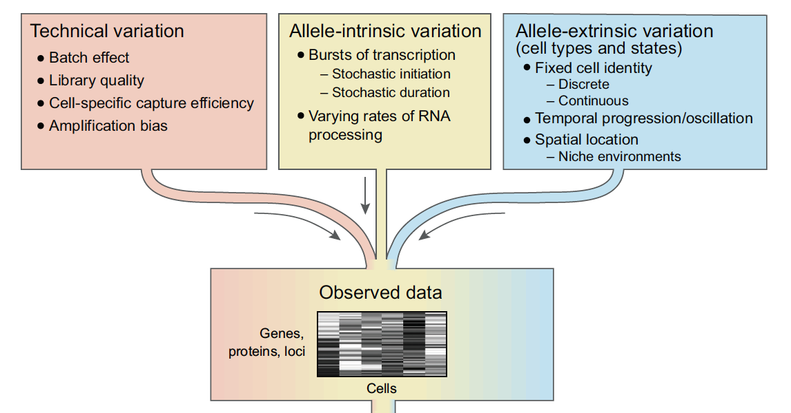
Expression has Many Sources per Cell

Slide 54
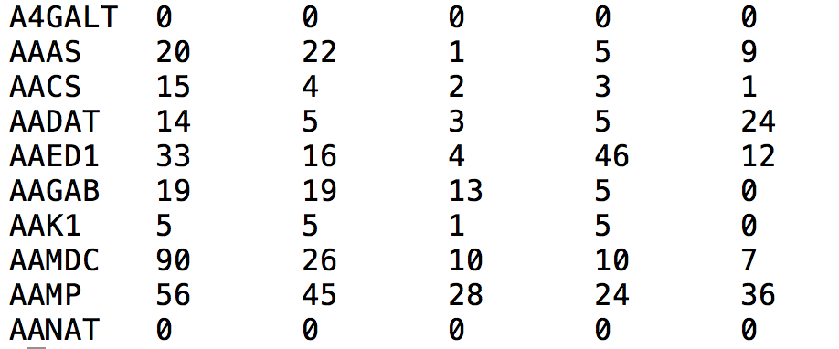
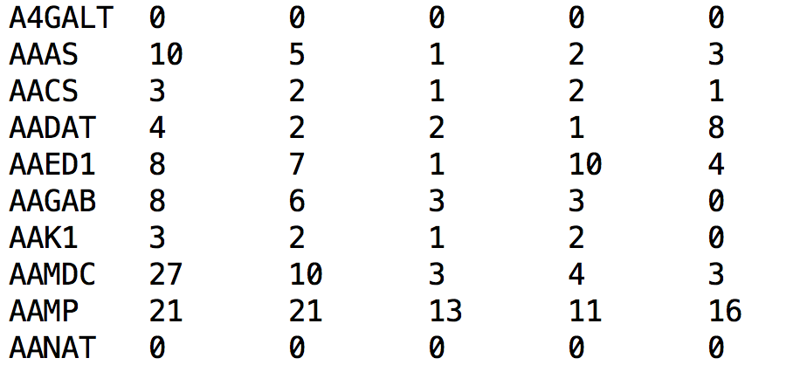
Data Analysis with UMIs
Read Counts
Counts by UMI
Collapsed but Not Linear

Slide 55
Summary of the Data
We are still understanding scData and how to apply it.
Data can be NOT normal.
Data can be Zero-inflated.
Data can be very noisy.
Cells vary in library complexity.
Can represent many “basis vectors” or sources of expression simultaneously.
Keeping these characteristics in analysis assumptions.
Tend to filter more conservatively with UMIs.

Slide 56

Section: Study Design and scRNA-Seq

Slide 57
scRNA-Seq Study Design
How many cells?
Can change depending on the variability of the biology and the expectation of finding rare populations.
How to design cell capture?
Single cell RNA-Seq is especially prone to technical batch affects (due to processing).
Use of UMIs
Use of ERCC spike-ins

Slide 58
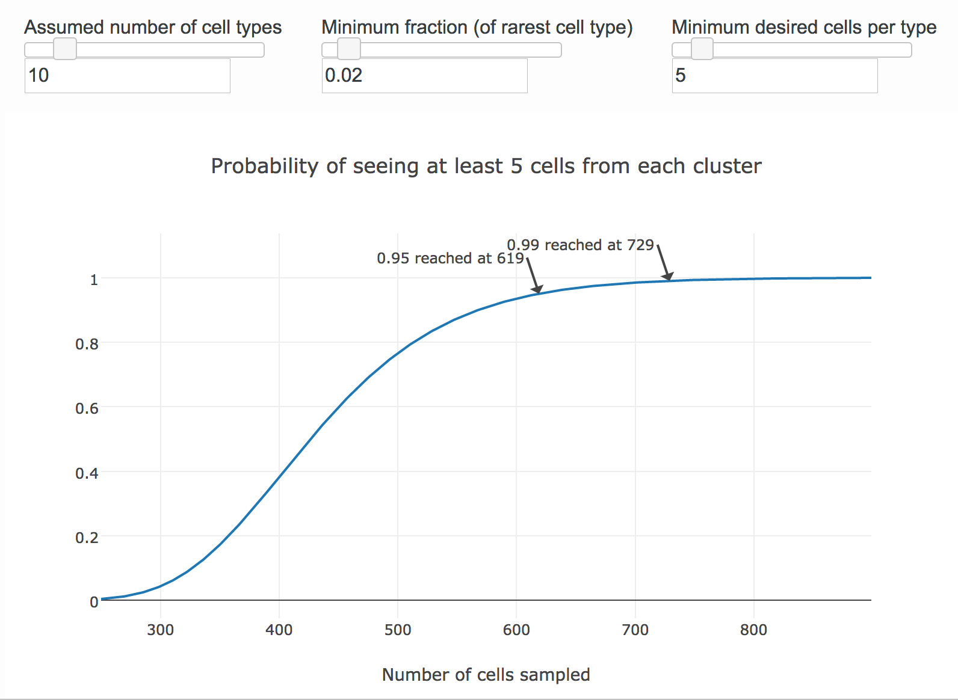
How Many Cells?
Satija lab online tool
satijalab.org/howmanycells

Slide 59
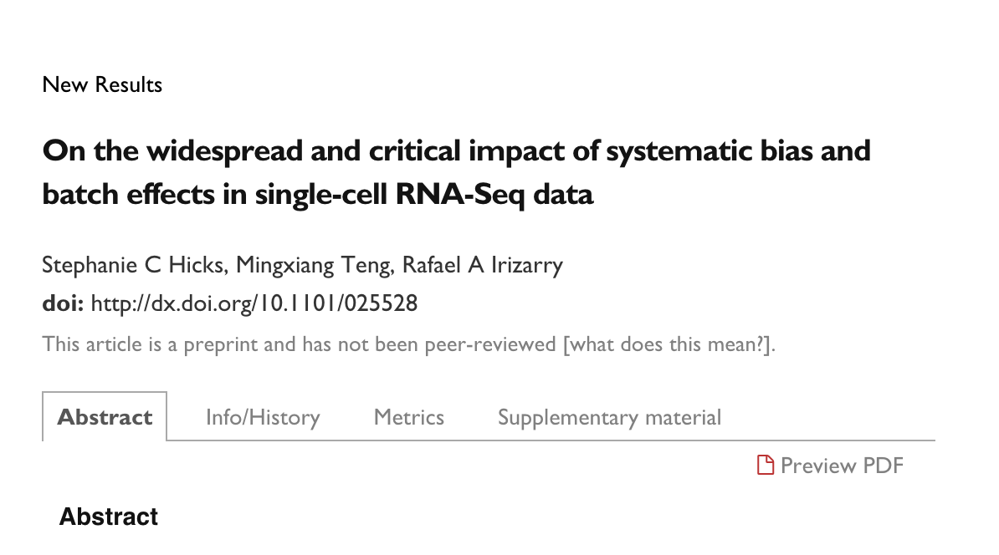
Single Cell RNA-Seq and Batch Affects

Slide 60
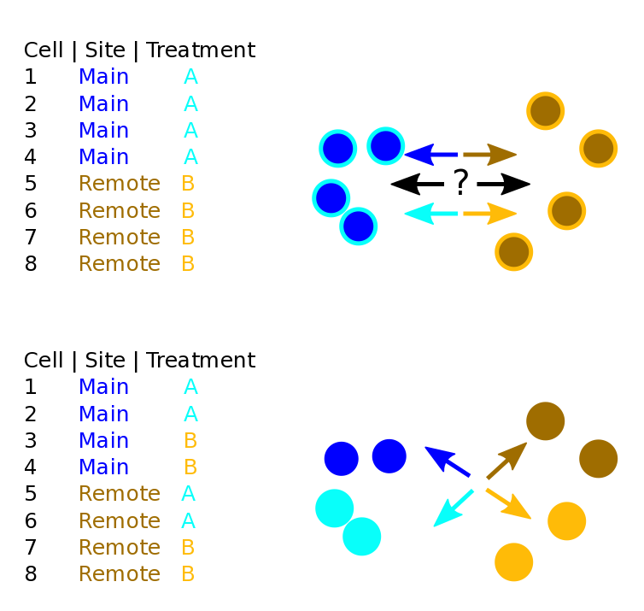
What is Study Confounding?

Slide 61
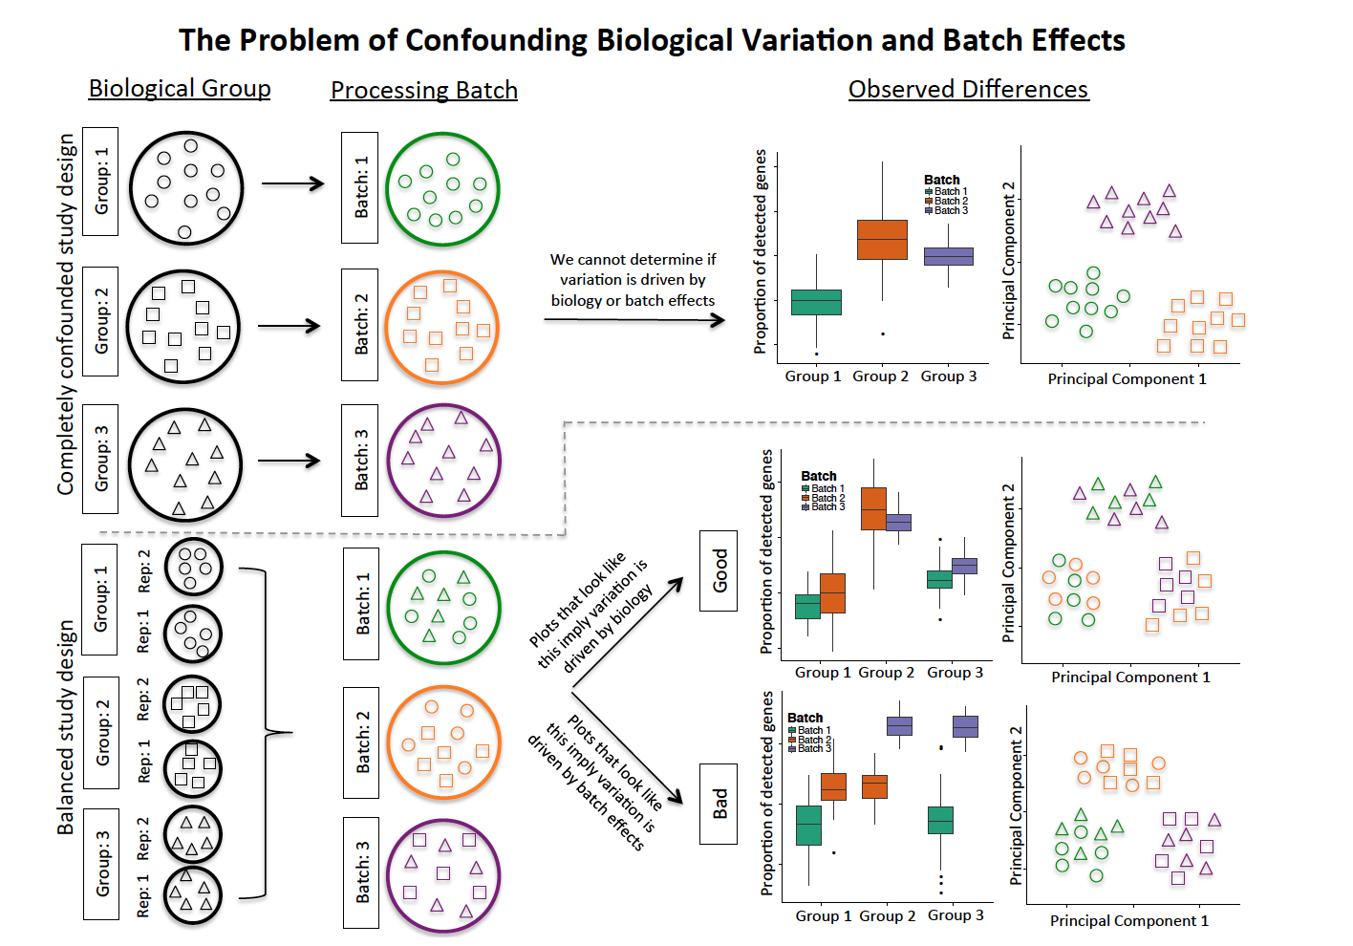
Confounding by Design

Slide 62

Section: Initial Data Analysis

Slide 63
Motivation: Why Am I Using R?
A lot of method development is happening in R.
Free / open source / open science.
Many supplemental computational biology packages.
Data science is an art.
Data often requires one to create and manipulate analysis.
This will allow you to experience key concepts in analysis.

Slide 64
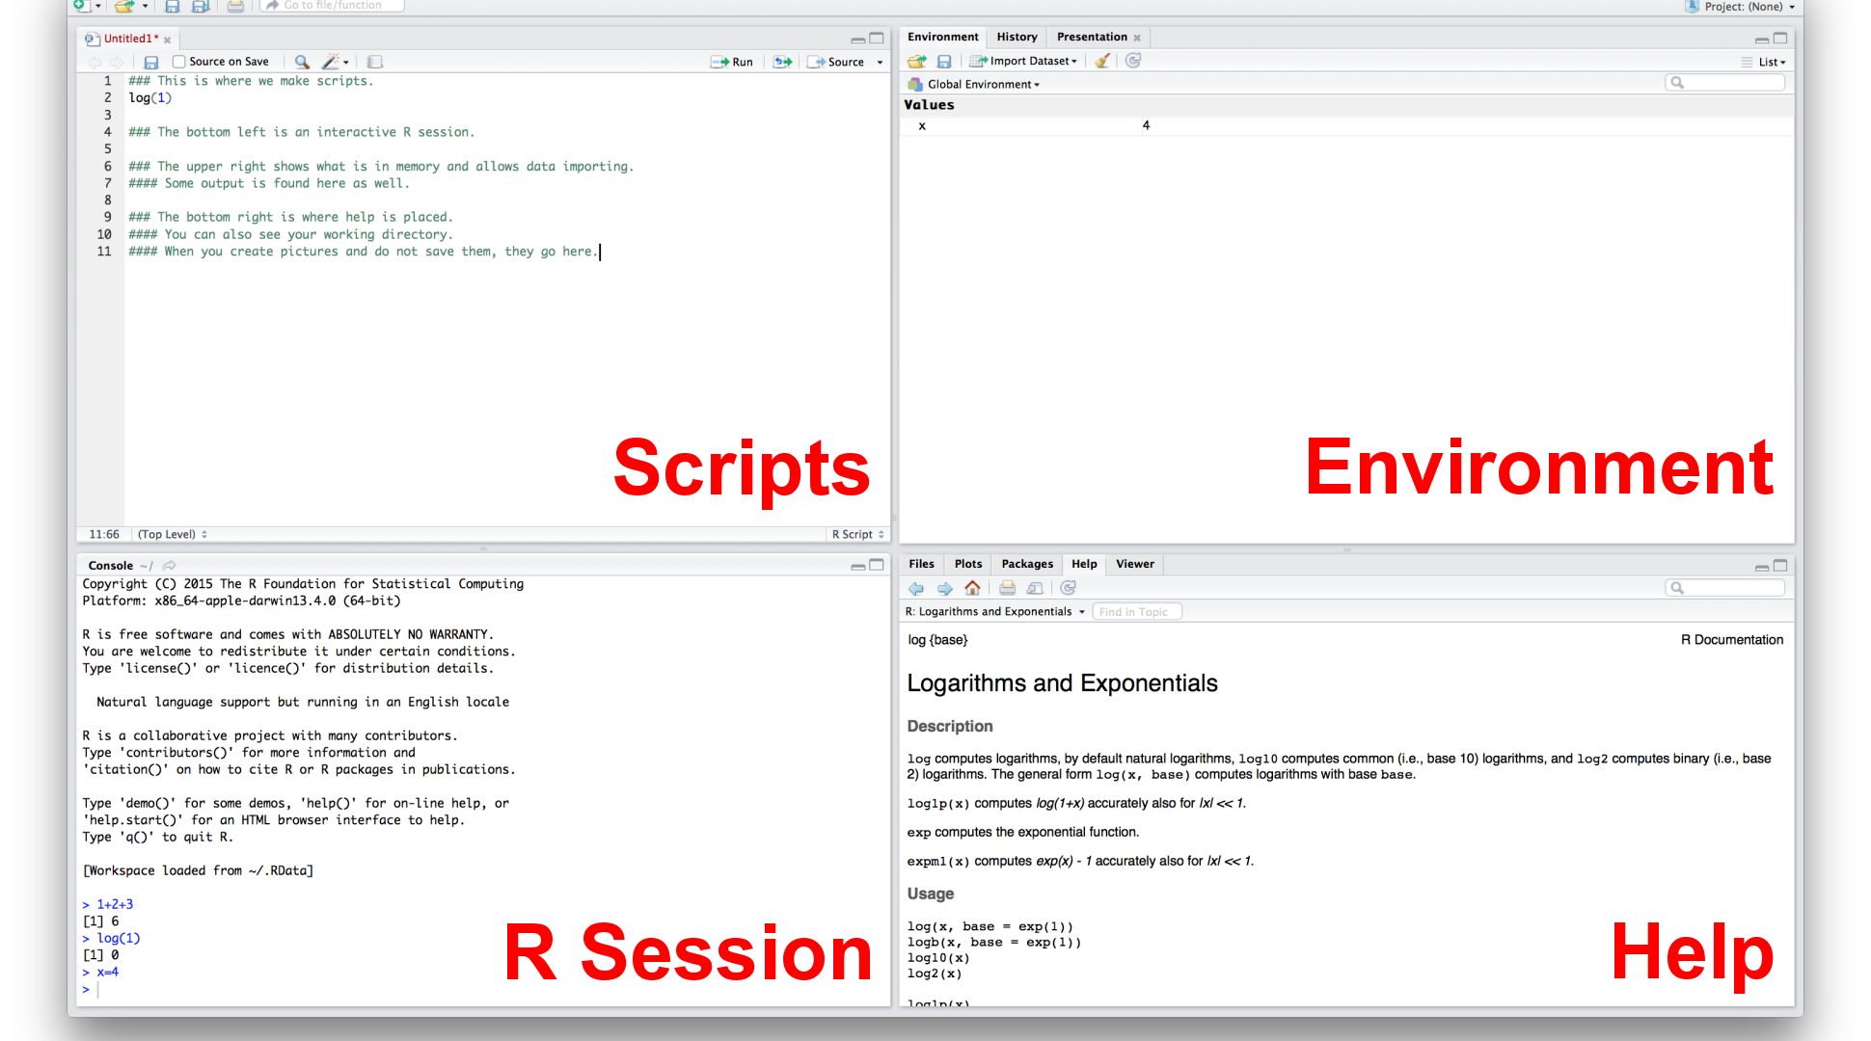
RStudio (IDE)

Slide 65

Initial Data Exploration

Slide 66
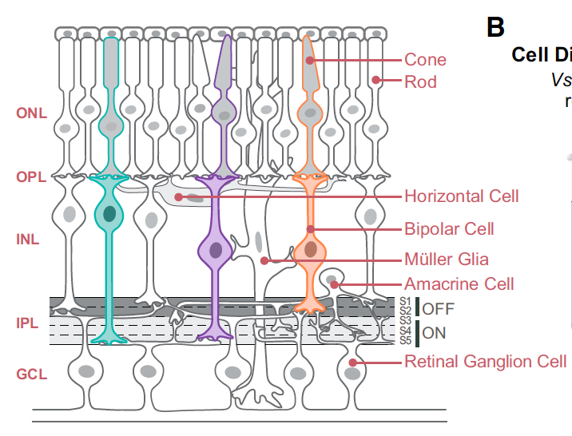
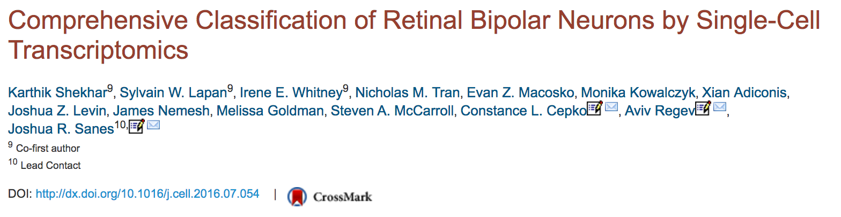


Today’s Data
To generate a comprehensive, validated classification scheme for the bipolar cells of the mouse retina.
Cone or rod type, ON or OFF, 9-12 subtypes (morphological)
~44k cells from a transgenic mouse line marking BCs
After filtering 27k (we use 5k)

Slide 67
Logistics: Importing Code Libraries
R Exercise

Slide 68
Representing Sparse Matrices
R Exercise

Slide 69
What is a Sparse Matrix?
Sparse Matrix
A matrix where most of the elements are 0.
Dense Matrix
A matrix where most elements are not 0.
Many ways to efficiently represent a sparse matrix in memory.
Here, the underlying data structure is a coordinate list.

Slide 70
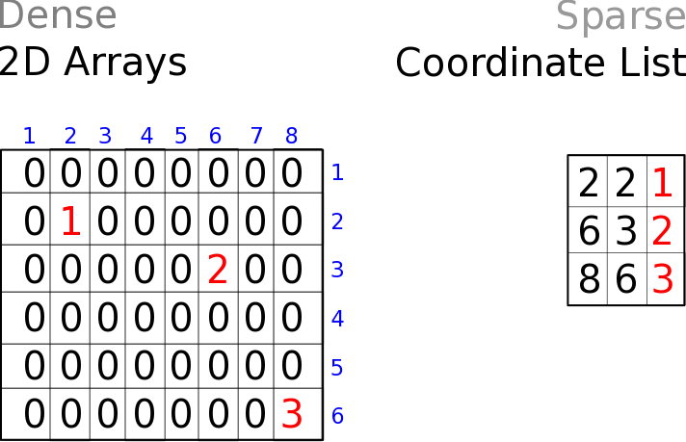
2D Arrays vs Coordinate Lists
Can be optimal for dense matrices
More optimal for sparse matrices
VS

Slide 71
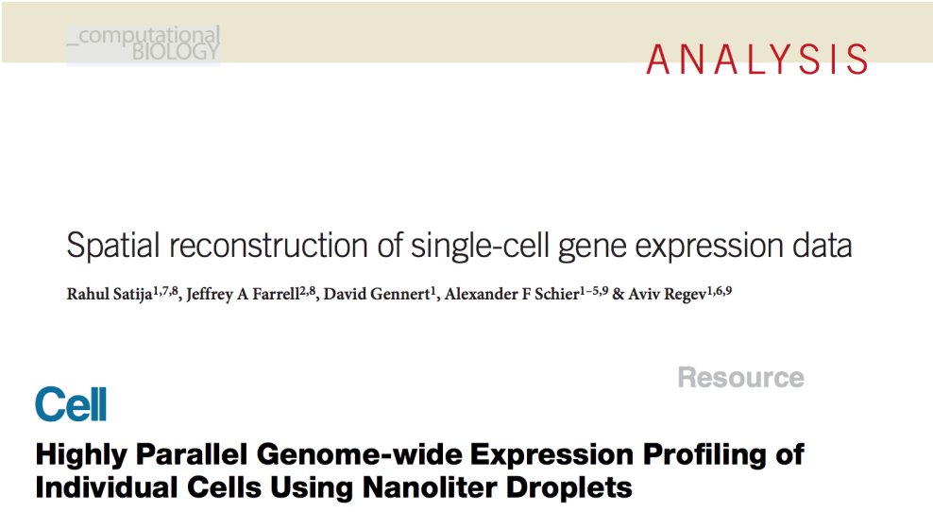
Seurat
https://github.com/satijalab/seurat

Slide 72
Create a Seurat Object
R exercise

Slide 73
Expression: Bulk RNA-Seq Definition
In bulk RNA-Seq we learned counts are not expression.
Some counts belong to sequences which could go to many genes.
Some transcripts are longer than other so they get sequenced more.
Some samples are more deeply sequenced.
The data is not normally distributed.
Depending on the scRNA-Seq assay these may be important.
Seurat has assumptions it makes with it’s defaults
More appropriate for 3 prime assays.

Slide 74

Count Preparation is Different Depending on the Source
RSEM
KALLISTO
RSEM
KALLISTO
No transcript length correction
TPM
Seurat
Correct for Sequencing Depth
X / Column Total * 1E5 or 1E6
Correct for Sequencing Depth
TPM
Seurat
Log2() + 1
Log2() + 1
Seurat

Slide 75
Prepping Counts For Seurat
3 prime-
Expected by Seurat.
Counts collapsed with UMIs.
Log2 transform (in Seurat).
Account for sequencing depth (in Seurat).
Full Transcript Sequencing-
Can be used in Seurat.
TPM +1 transformed counts.
Log2 transform (in Seurat).
Sequencing depth is already accounted.

Slide 76
Sometimes Averages are Not Useful
Say you were standing with one foot in the oven and one foot in an ice bucket. According to the percentage people, you should be perfectly comfortable. –Bobby Bragan

Slide 77

Filtering Genes: Averages are Less Useful

Slide 78

Filtering Genes: Using Prevalence

Slide 79

Filtering Genes: Using Prevalence

Slide 80

Filtering Using Metadata

Slide 81
What is Metadata?
Other information that describes your measurements.
Patient information.
Life style (smoking), Patient Biology (age), Comorbidity
Study information.
Treatment, Cage, Sequencing Site, Sequencing Date
Sequence QC on cells.
Useful in filtering.

Slide 82
Filtering Cells: Removing Outlier Cells
Bulk RNA-Seq studies often do not remove outliers cells
scRNA-Seq often removes “failed libraries”.
Outlier cells are not just measured by complexity
Percent Reads Mapping
Percent Mitochondrial Reads
Presence of marker genes
Intergenic/ exonic rate
5' or 3' bias
other metadata …
Useful Tools
Picard Tools and RNASeQC

Slide 83
Seurat: Filtering on Metadata
R Exercise

Slide 84

Section: Plot Genes

Slide 85
Seurat: Viewing Specific Genes
R Exercise

Slide 86

Section: Working with Batch Affects

Slide 87
Normalization and Batch Affect Correction
The nature of scRNA-Seq assays can make them prone to confounding with batch affects.
Normalization and batch affect correction can help.
Some are moving away from relying on a specific method.
Exploring the idea of combining or selecting from a collection of normalization or correction methods best for a specific study.
Some believe UMI based analysis need not be normalized between samples given the absolute count of the molecules are being reported.
Be careful not to remove biological signal with good experimental design (avoiding confounding by design).

Slide 88
Seurat and Batch Affect Correction
Using linear models one can regress covariates.
scale.data hold the residuals after regressing (z-scored)
Dimensionality reduction and clustering.
We use metadata we have.
One could imagine creating a metadata for cell cycle.

Slide 89
Seurat and Batch Affect Correction
R exercise

Slide 90

Section: Dimensionality Reduction and Plotting Samples

Slide 91
Dimensionality Reduction
Start with many measurements (high dimensional).
Want to reduce to few features (lower-dimensional space).
One way is to extract features based on capturing groups of variance.
Another could be to preferentially select some of the current features.
We have already done this.
We need this to plot the cells in 2D (or ordinate them)
In scRNA-Seq PC1 may be complexity.

Slide 92

PCA: in Quick Theory
Eigenvectors of covariance matrix.
Find orthogonal groups of variance.
Given from most to least variance.
Components of variation.
Linear combinations explaining the variance.

Slide 93
PCA: an Interactive Example
PCA Explained Visually

Slide 94
PCA: in Practice
Things to be aware of-
Data with different magnitudes will dominate.
Zero center and divided by SD.
(Standardized).
Can be affected by outliers.
Data is often first filtered to remove noise.

Slide 95

t-SNE: Nonlinear Dimensional Reduction

Slide 96

t-SNE: Collapsing the Visualization to 2D

Slide 97

t-SNE: How it works.

Slide 98
PCA and t-SNE Together
Often t-SNE is performed on PCA components
Liberal number of components.
Removes mild signal (assumption of noise).
Faster, on less data but, hopefully the same signal.

Slide 99
Learn More About t-SNE
Awesome Blog on t-SNE parameterization
http://distill.pub/2016/misread-tsne
Publication
https://lvdmaaten.github.io/publications/papers/JMLR_2008.pdf
Nice YouTube Video
https://www.youtube.com/watch?v=RJVL80Gg3lA
Code
https://lvdmaaten.github.io/tsne/
Interactive Tensor flow
http://projector.tensorflow.org/

Slide 100

Plotting Cells

Slide 101
Plotting Cells and Gene Expression
R exercise.

Slide 102


Defining Clusters through Graphs
Smart Local Moving (SLM) algorithm for community (cluster) detection in large networks.
Can be applied to 10s of millions cells, 100s of millions of relationships.
Evolved from the Louvain algorithm
http://www.ludowaltman.nl/slm/
Notes:
The modularity of a network is a value
that is between -1 and 1. This value presents the density of
links inside communities over the density of links between
communities.

Slide 103
Local Moving Heuristic
1
2
3
4
5
6
7
Notes:
This is the louvain algorithm, the difference with this and the SLM is that when communities are made the community is broken down to nodes and then larger communities are recreated, incase one node would better live in another community.

Slide 104
Section Summary
Dimensionality reduction help reduce data while hopefully keeping important signal.
t-SNE on PCA is often used in analysis
Created several types of plot often seen in publications.
Plotting genes (through subgroups).
Ordinating cells in t-SNE space.
Heat maps of genes associated with PC components.
Plotting metadata on projects of data is an important QC tool.
Cluster of cells are currently defined through graph, separate from the ordination (t-SNE / PCA).

Slide 105

Section: Differential Expression

Slide 106
Seurat: Differential Expression
Default if one cluster again many tests.
Can specify an ident.2 test between clusters.
Adding speed by exluding tests.
Min.pct - controls for sparsity
Min percentage in a group
Thresh.test - must have this difference in averages.

Slide 107
Seurat: Many Choices for DE
bimod
Tests differences in mean and proportions.
roc
Uses AUC like definition of separation.
t
Student's T-test.
tobit
Tobit regression on a smoothed data.

Slide 108
Seurat: DE and Plotting DE Genes
R Exercise.

Slide 109

Dot plots
prevalent genes
sparse genes
Size of circle
Gene prevalence in cluster.
Color of circle
More red, more expressed in cluster.
Scales well with many cells.
lowly
expressed
highly
expressed
very
specific

Slide 110

Mast
Uses hurdle model
Two part generalized linear model to address both rate of expression (prevalence) and expression.
GLM means covariates can be used to control for unwanted signal.
CDR: Cellular detection rate
Cellular complexity
Values below a threshold are 0
Additionally introduces a GSEA method.
https://github.com/RGLab/MAST

Slide 111
Mast: Hurdle Models
Logistic Regression
Gaussian Linear Model

Slide 112
Mast: DE and Plotting DE Genes
R Exercise.

Slide 113
Section: Communicating Results to Collaborators
Designing a study.
Writing a grant.
Performing experiments.
Collecting data.
Running sequencing pipelines.
Performing some preliminary analysis.
Sharing ideas with private collaborators.
Refining analysis.
Completing a paper.
Sharing analysis publicly.

Slide 114

The Single Cell Portal
https://portals.broadinstitute.org/single_cell

Slide 115

The Single Cell Portal
Study Descriptions Can Be Created

Slide 116

The Single Cell Portal
Data Can Be Shared

Slide 117

The Single Cell Portal
One Can Interact with Cell Clusters

Slide 118

The Single Cell Portal
Gene Expression Can be Viewed Across Clusters

Slide 119

The Single Cell Portal
Gene Expression Can be Viewed Across Clusters

Slide 120

The Single Cell Portal
Multiple Clustering Can be Used

Slide 121

The Single Cell Portal
Genes Can Be Viewed in Many Clusters

Slide 122

The Single Cell Portal
Expression Can Be Shown in Many Clusterings

Slide 123

The Single Cell Portal
Expression in Clusters Can Also Be Shown as Heatmaps

Slide 124
The Single Cell Portal
Studies can be …
Private
Private but shared privately
Public but with data inaccessible
Public

Slide 125
Section: Wrapping Up What Did We Miss (So Much)?
So much more to learn!
We covered this

Slide 126


Awesome List
https://github.com/seandavi/awesome-single-cell

Slide 127

Single Cell Network
www.singlecellnetwork.org

Slide 128
Thank You
Aviv Regev
Brian Haas
Adam Haber
Anindita Basu
Asma Bankapur
Chloe Villani
Karthik Shekhar
Kristine Schwenck
Matan Hofree
Michel Cole
Monika Kowalczyk
Nir Yosef
Sean Simmons
Regev Single Cell Working Group
Today's Attendees

Slide 129

Questions?

